Slide 1

The architecture
What comes after the workspace!
Notes:
The front end development is getting just as complex as the backend development[1].
Front-end technologies and architecture choices are pivotal to improving the perceived quality and user experience of software applications [6].
Following the right principles and guidelines, development teams can architect, design and develop sustainable solutions.
With the support of a monorepo style workspace, powered by Nx, we are putting ourselves in a good position to succeed.

Slide 2
EXPORT CLASSIFICATION
x
Check this box if presentation contains “no technical data” OR summarize the export classifications of all slides in this presentation as instructed below:
Instructions: Box 1 and one (1) of boxes 2-5 must always be completed
 | Classification:
1. Canadian ECL(s):
2. ECCN(s) (EAR):
3. P-ECCN(s) :
4. USML (ITAR):
5. P-USML:
PROPRIETARY NOTICE
This document is the property of Pratt & Whitney Canada Corp. (“P&WC”). You may not possess, use, copy or disclose this document or any information in it, for any purpose, including without limitation to design, manufacture, or repair parts, or obtain TCCA, FAA, or other government approval to do so, without P&WC's express written permission. Neither receipt nor possession of this document alone, from any source, constitutes such permission. Possession, use, copying or disclosure by anyone without P&WC's express written permission is not authorized and may result in criminal or civil liability.
2

Slide 3
Agenda
1- High level architecture-30 000 ft
2- Core architectural patterns in ADRs
3- Wrap-up & Voting

Slide 4
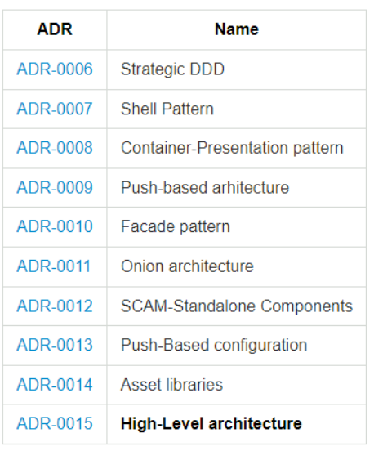
ADRs

Slide 5

One architecture to rule them all! Why so many ADRs then?
Decisions evolve separately
Technology can change leading to better decisions
Concepts easier to explain in isolation

Slide 6
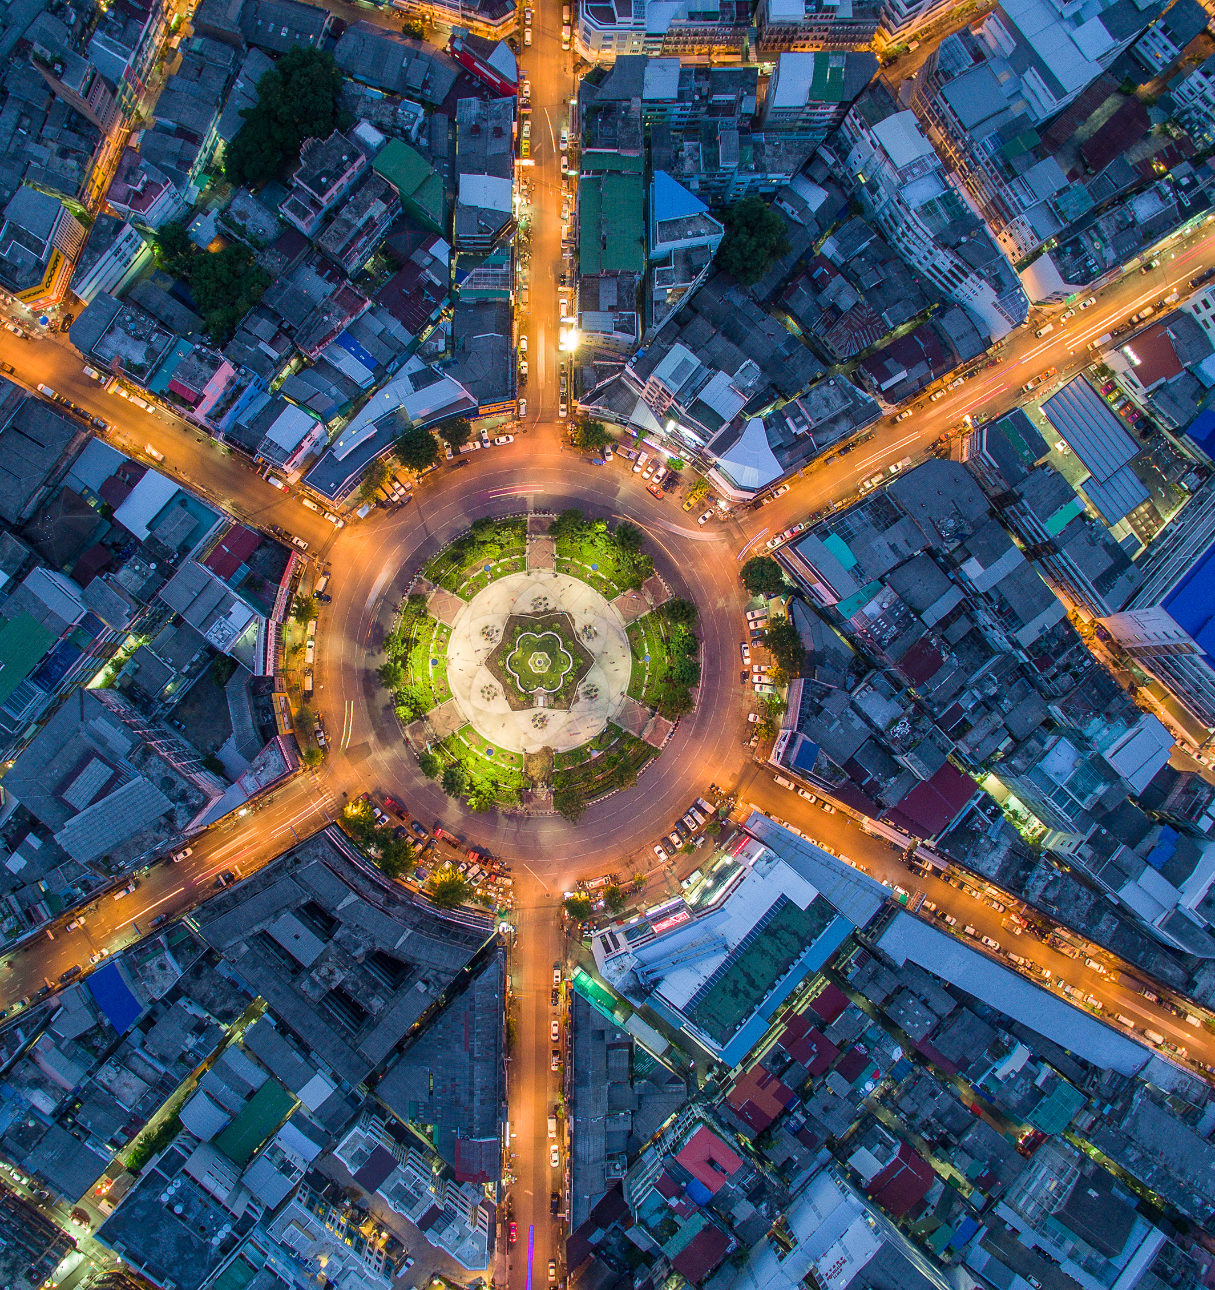
High-level architecture
30 000 ft (may be 10 000 ft!)

Slide 7
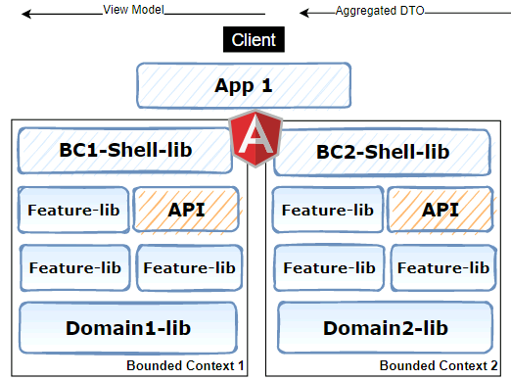
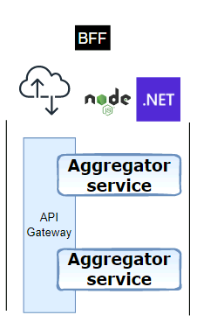
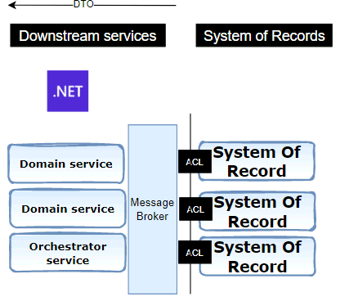
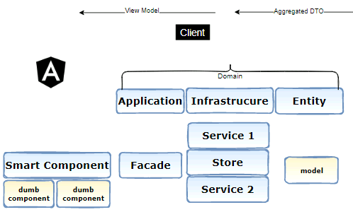

High-level architecture

Slide 8
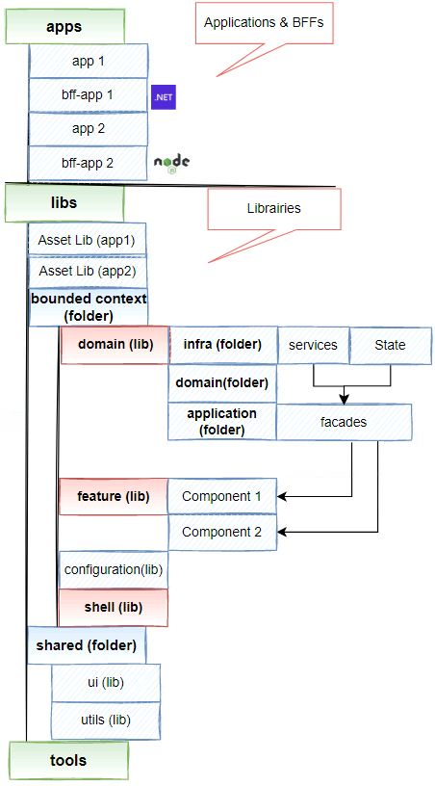
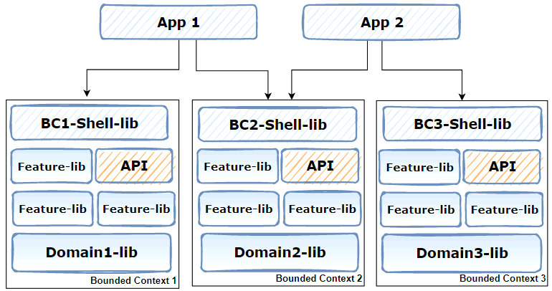
Mapping: architecture & code structure

Slide 9
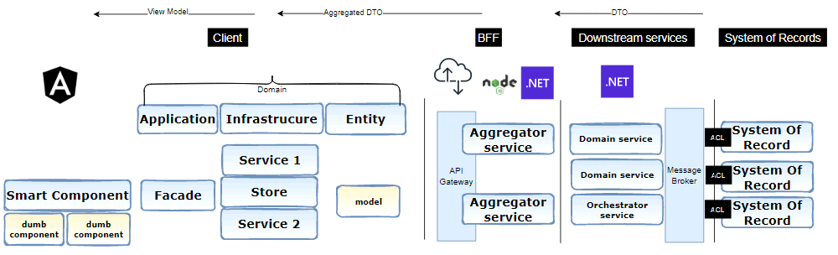
Another view!

Slide 10
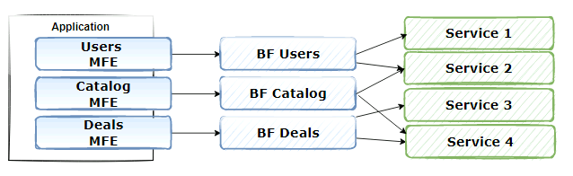
BFF Vision

Slide 11
FE Architecture foundation
Strategic DDD
Onion architecture
Shell pattern
Push-Based architecture
Container-Presentation pattern
Facade pattern

Slide 12
Strategic DDD
Strategic DDD
Reactive programming
Shell pattern
Facade pattern
Container-presentation pattern
Onion architecture

Slide 13
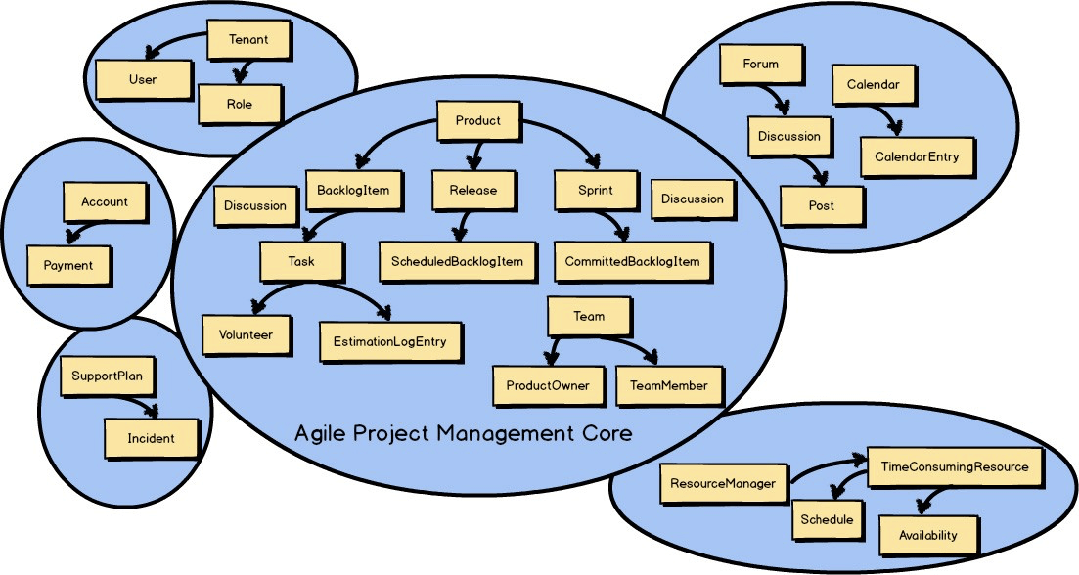
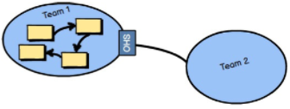
Strategic DDD value
Identify bounded context
Event Storming helps… (out-of-scope)
Heuristics:
Organizational structure
Vocabulary: Ubiquitous Lang.
Pivotal events
Open host service pattern (OHS)
Public API or Barrel
Allows other BC to consume current BC public interface
(ACL):systems of records
Allow for level of isolation
with access restrictions rules from Nx

Slide 15

Shell pattern
Strategic DDD
Push-Based architecture
Shell pattern
Facade pattern
Container-Presentation pattern
Onion architecture

Slide 16
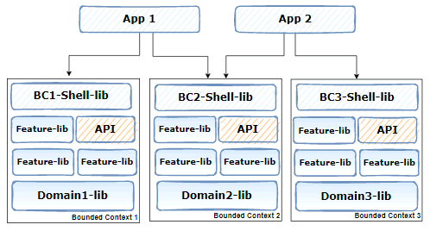
A shell per bounded context
Entry point for a BC
Arrange routes and features of One BC
Decouples the App from internal features

Slide 17
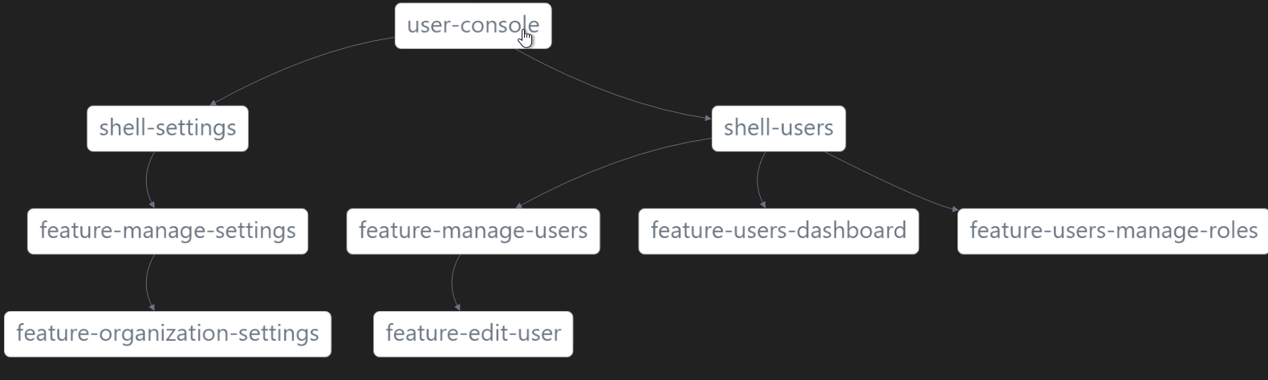
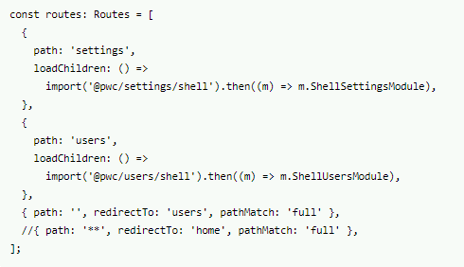
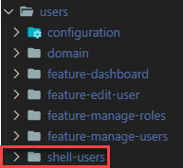
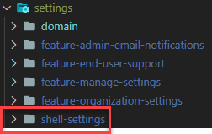
Example: Shells in the graph

Slide 18
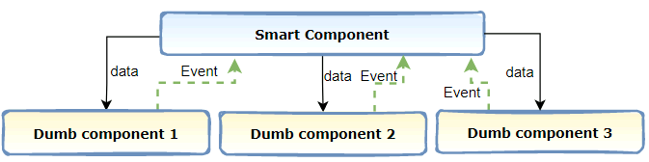
Container-Presentation pattern
Strategic DDD
Push-Based architecture
Shell pattern
Facade pattern
Container-Presentation pattern
Onion architecture

Slide 19

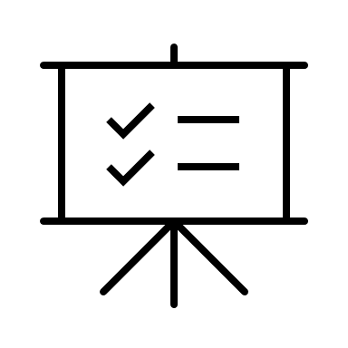
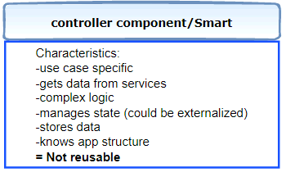
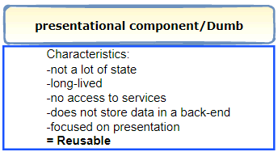
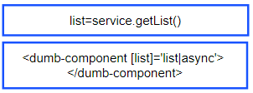
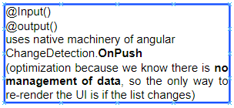
How it works?
Notes:
DUMB:
1-Focus on the UI: Almost all basic UI components should be considered dumb components. Examples include loaders, modals, buttons, inputs, etc.
2-Accept props: Dumb components accept props to allow them to be dynamic and reusable. For example, you might send the title of a button in props from the parent component to allow it to have a unique name.
3-Require no app dependencies: Other than UI packages, like material or bootstrap, dumb components do not require dependencies.
4-Rarely include state: The only instance where a dumb component has state is for manipulating the UI itself, not application data. Some examples of where a dumb component might have state would be button groups, tabs, switches and other UI elements that do not impact the data, only the UI.
SMART:
Manipulates Data Smart components can fetch, capture changes and pass down application data.
Call Redux, Lifecycle methods, APIs, Libraries, etc These components are called smart for a reason! They are responsible for calling libraries and functionality.
Manage state Smart components are responsible for managing state and knowing when to re-render a component.
Rarely includes styling Since dumb components focus on styling, it allows the smart component to focus on functionality without the clutter of styles too.
https://www.digitalocean.com/community/tutorials/react-smart-dumb-components

Slide 20
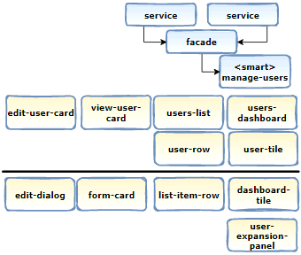
Example
Use case-specific presentational component (feature)
presentational component (shared)
Notes:
Benefits of separating Dumb and Smart:
Even easier with conventions: tile,card,row, card to imply presentational

Slide 21
Benefits
UI composition
Code Readability
Reusability
Easy to change
Better collaboration btw components
Easy to test
Notes:
Benefits of separating Dumb and Smart:
Even easier with conventions: tile,card,row, card to imply presentational

Slide 22

Push-based architecture
Strategic DDD
Push-Based architecture
Shell pattern
Facade pattern
Container-Presentation pattern
Onion architecture
Notes:
Benefits of separating Dumb and Smart:
Even easier with conventions: tile,card,row, card to imply presentational

Slide 23
Overview
Declarative vs Imperative
Reactive is a declarative programming paradigm
Push-based architecture
Streams all the way!
Notes:
Reactive architecture is a declarative programming paradigm where the state in the system is managed through data streams and events as a contrast to explicitly managing state through commands as in imperative programming

Slide 24
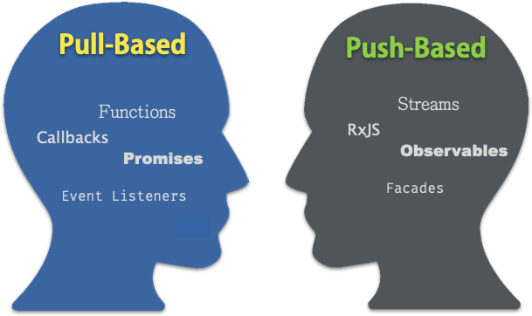
Reactive programming: push vs pull Paradigm shift
State Management
Immutability
Performance
Reactive Views

Slide 25
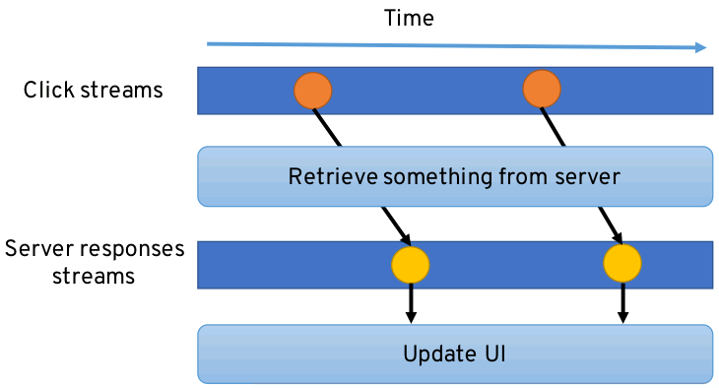
UI reacts to data streams: don’t call us we call you!

Slide 26
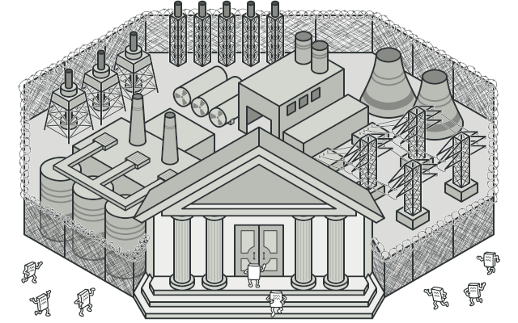
Façade pattern
Strategic DDD
Push-Based architecture
Shell pattern
Façade pattern
Container-Presentation pattern
Onion architecture
Notes:
Benefits of separating Dumb and Smart:
Even easier with conventions: tile,card,row, card to imply presentational

Slide 27
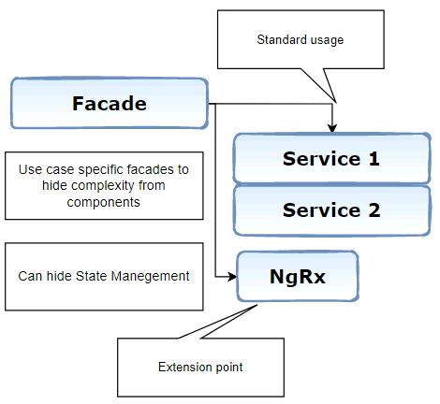
Benefits
Hide complexity
Simplify access and modification of NgRx
Backward compatibility
Shared Data

Slide 28
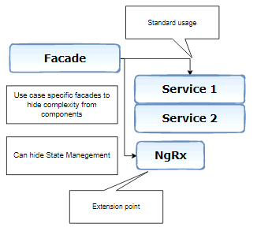
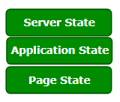
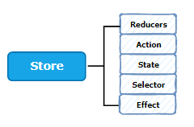
Façade pattern (extended)
State management (NgRx)

Slide 29
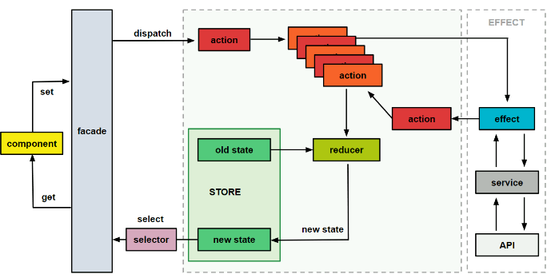
Facades for smart components
Services
Orchestration
State management
Shared Data

Slide 30

Onion architecture
Strategic DDD
Push-Based architecture
Shell pattern
Facade pattern
Onion architecture
Container-Presentation pattern
Notes:
Benefits of separating Dumb and Smart:
Even easier with conventions: tile,card,row, card to imply presentational

Slide 31
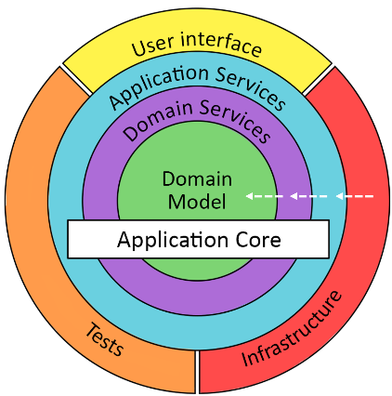
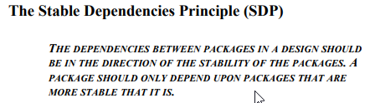

Onion architecture: The theory

Slide 32
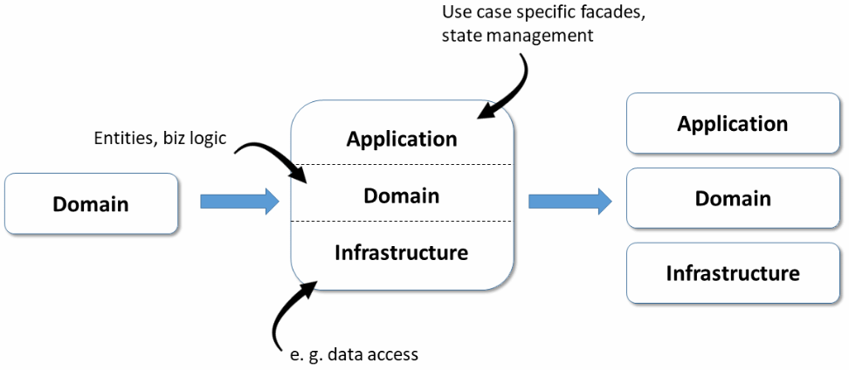
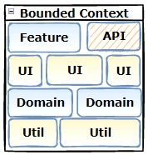
Domain: onion architecture

Slide 33
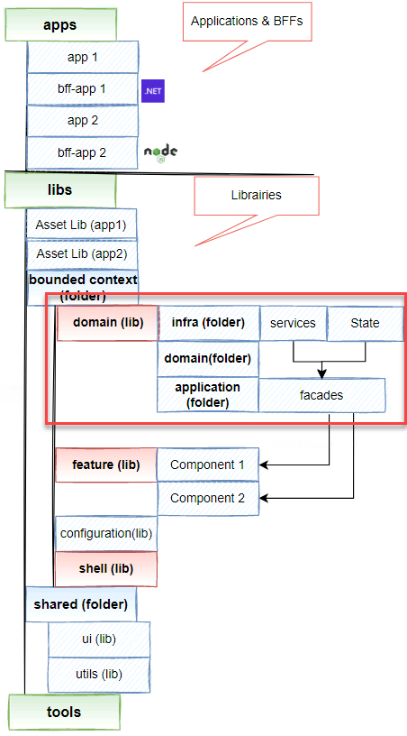

Add another piece…

Slide 34
Benefits (client-side)
Domain driven approach
Enforcing the stability principle
Enforcing single responsibility principle
Resulting on more flexibility: easier to maintain and modernize
Notes:
Domain focus on domain logic
Application focus on use cases
Infrastructure supports and injects services to upper layers

Slide 35
Two more specific decisions
1- How to push application configuration to libraries
2- How to access library assets from application

Slide 36

Push-Based Configuration
Strategic DDD
Push-Based architecture
Shell pattern
Façade patterns
Container-Presentation pattern
Onion architecture
Notes:
Benefits of separating Dumb and Smart:
Even easier with conventions: tile,card,row, card to imply presentational

Slide 37

The problem
Notes:
There are many opportunities to create libraries for our Angular applications.
However, one of the difficulties is getting the configuration to these libraries.
## Problem
Angular applications have an environment context that provides configuration items targeting specific environments for the application.
Angular libraries in the Workspace cannot access the environment context.
Applications reference and use libraries — and Angular Libraries may reference and use other libraries. If libraries had access to the environment context it would cause a circular dependency.
One of the main tenets of developing reusable libraries is to keep them generic enough to be reused by many applications and libraries [1].

Slide 38
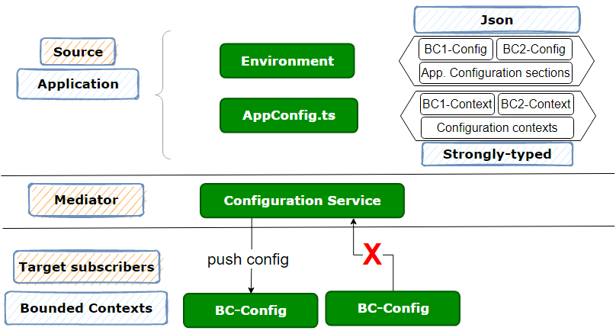
Push-Based Configuration
Notes:
- Each library will define its own configuration schema or object type
- Each library will define an interface for the structure of the specific configuration
each library will subscribe to publish events of configuration
- Library configuration will be pushed to libraries
- Each library has the responsibility to validate the configuration provided
- Each library has the responsibility to define default values for any required items.
- Each application will retrieve the configuration
- A service will provide the mechanism to publish configuration to library subscribers.

Slide 39
Assets
Notes:
Benefits of separating Dumb and Smart:
Even easier with conventions: tile,card,row, card to imply presentational

Slide 40
Add another piece…

Slide 41

Assets
Strategic DDD
Push-Based architecture
Shell pattern
Façade patterns
Container-Presentation pattern
Onion architecture
Notes:
Benefits of separating Dumb and Smart:
Even easier with conventions: tile,card,row, card to imply presentational

Slide 42
Wrap-up: High-level architecture
30 000 ft (may be 10 000 ft!)

Slide 43
High-level architecture

Slide 44
Mapping: architecture & code structure

Slide 45

Thanks…

Slide 46

Questions…
Before voting!

Slide 47
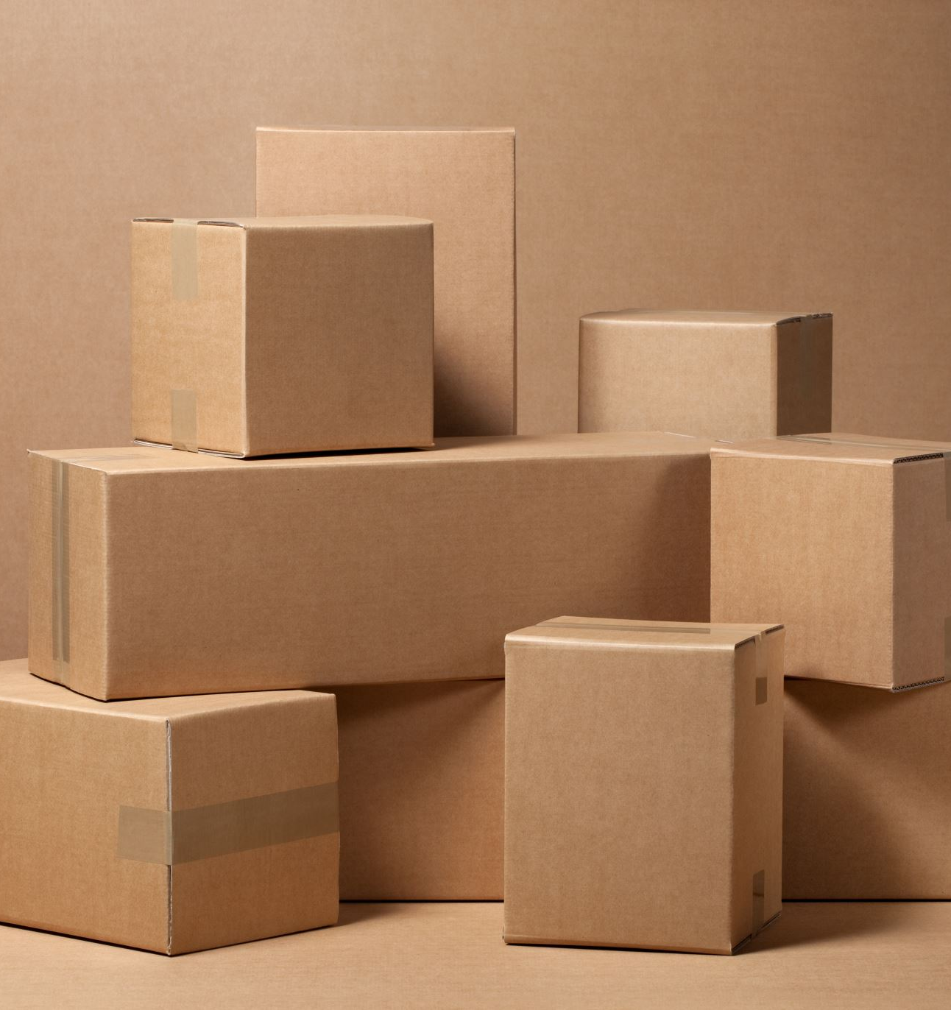
Extras!

Slide 48
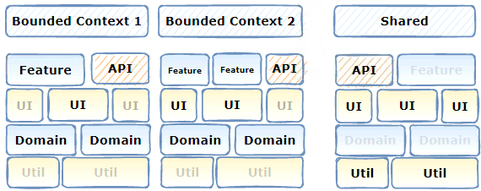
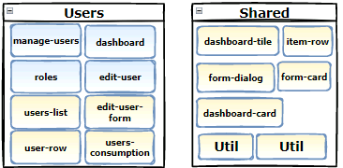
DDD + container-presentation pattern

Slide 49
Voting Time!

Slide 50

Thank you

Slide 51
1-Enterprise concerns
Consistency
Safety
Sustainability
Changing requirements
Notes:
While small projects or apps do not require a deep thinking on how to organize code due to their simplistic nature, enterprise or large projects have more serious concerns that requires a deep understanding because of the huge impact that may have.
Small teams can manage somehow the complexity of a small projects. Large teams requires more tools and a shift in thinking.
T1-**Consistency** — how do we make sure that everyone in the organization follows the same best practices for structuring and writing code?
coding best practices
application structure
- T2-**Safety** — how do we ensure that our code will not be subject to attacks or prone to errors?
- T3-**Increased size and complexity** — how can we structure our code so that it can grow without sacrificing clarity or performance?
T4-**Changing requirements** — how can we keep up with the demands of the business to continually update the application without letting technical debt get out of control?
Here where mono repos shine…

Slide 52
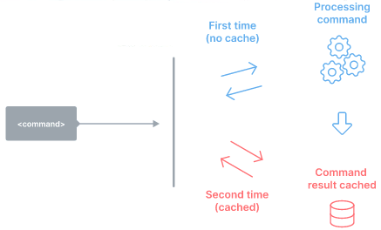
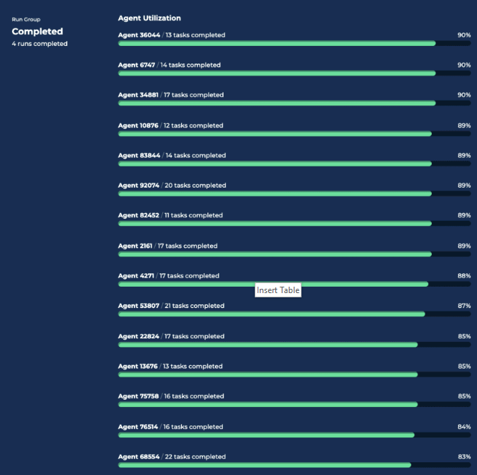
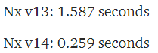
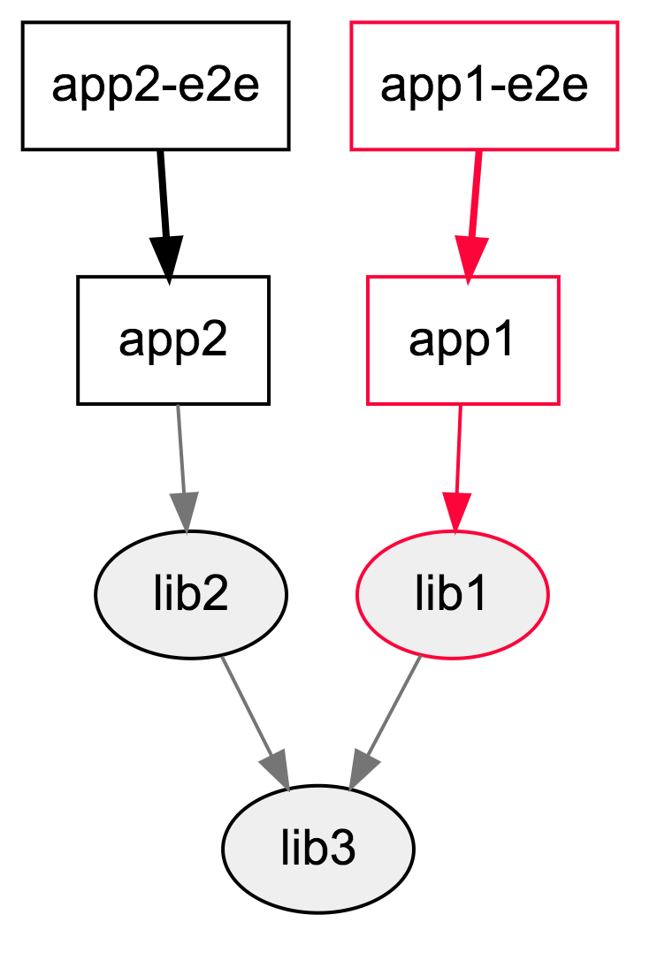
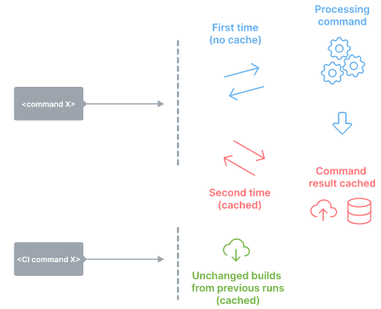
Fast
Distributed task execution
Local computation caching
Affected!
Notes:
- **Code sharing**: Facilitates sharing of discrete pieces source code. Sharing could be done in different ways. For example, Nx allow any folder of files to be marked as a project and can be shared. Nx plugins help configure WebPack, Rollup, TypeScript and other tools to enable sharing without hurting dev ergonomics. In the other hand Lerna supports it only by sharing npm packages.
- **Consistent Tooling**:
The tool helps you get a consistent experience regardless of what you use to develop your projects: different JavaScript frameworks, Go, Rust, Java, etc.
In other words, the tool treats different technologies the same way.
- **Code generation**: Native support for generating code.
- **Project constraints and visibility**:
Supports definition of rules to constrain dependency relationships within the repo. For instance, developers can mark some projects as private to their team so no one else can depend on them. Developers can also mark projects based on the technology used (e.g., React or Nest.js) and make sure that backend projects don't import frontend ones.

Slide 53
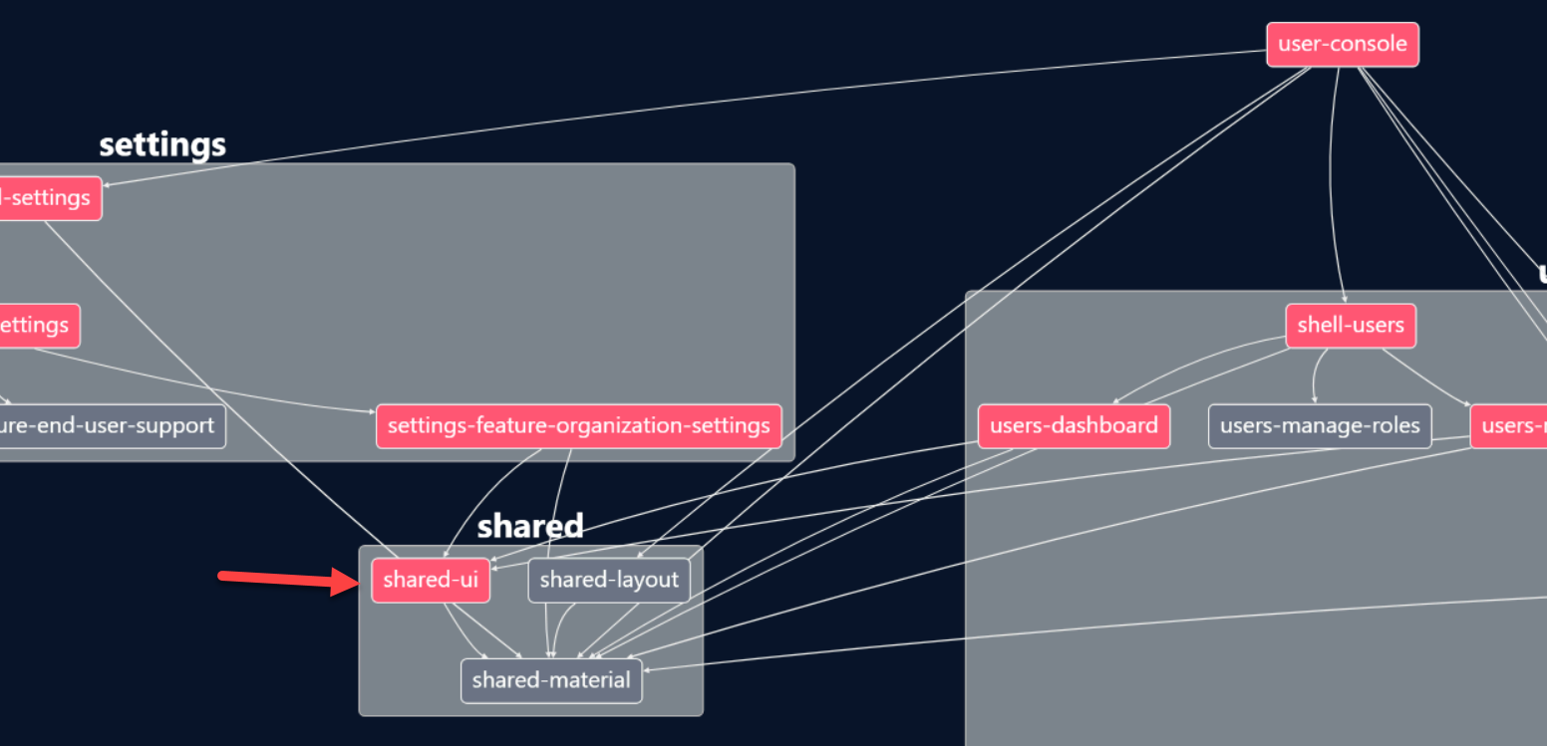
Fast-Detecting affected projects/packages
Notes:
- Detecting affected projects/packages:Determine what might be affected by a change, to run only build/test affected projects.

Slide 54
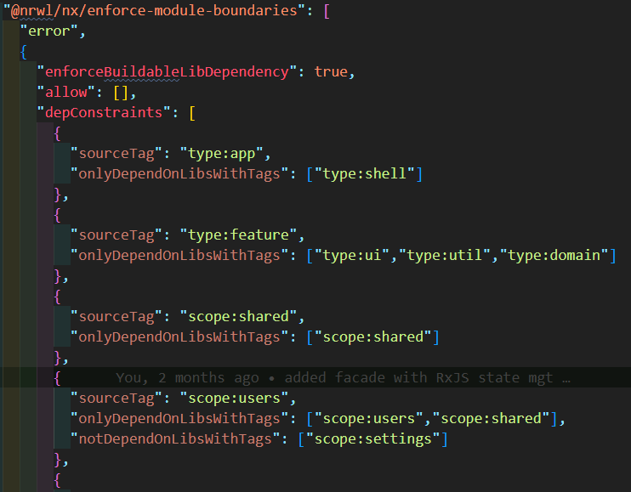
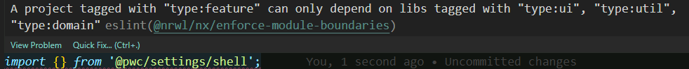
Dependencies constraints

Slide 55
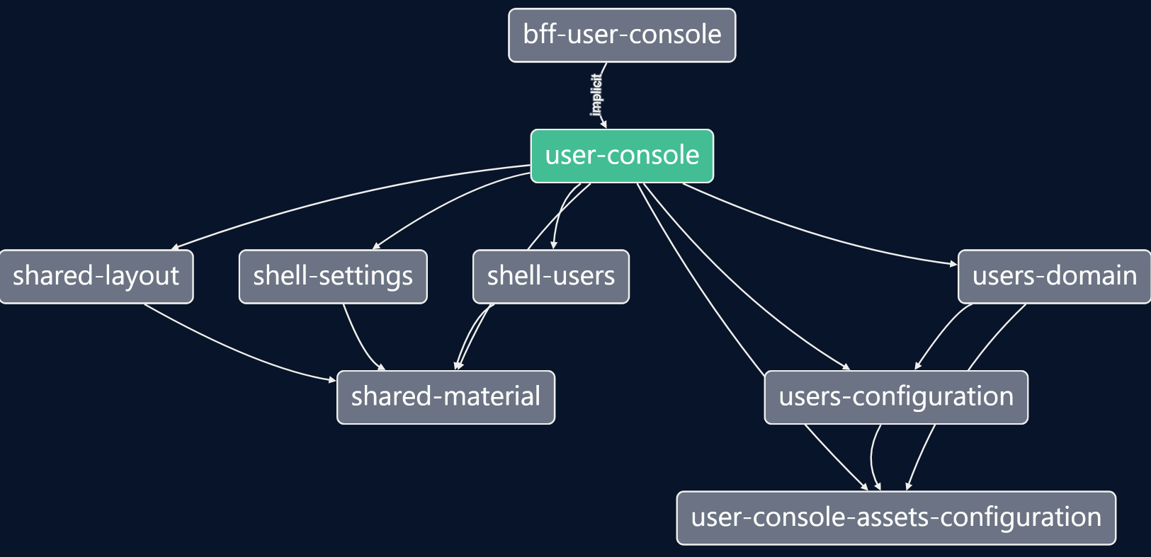

Dot-net extension for BFF support

Slide 56
4-Schematics
Schematics=Generators

Slide 57
Plugins: written using Nx Devkit
Generators
Executors
Generators automate making changes to the file system.
Anytime you run nx generate ..., you invoke a generator.
They are used to create/update applications, libraries, components, and more.
Executors perform actions on your code. This can include building, linting, testing, serving and many other actions.

Slide 58
Generators?
Nx Core plugin generators :
nx g @nrwl/angular:…/Nx Console
Update generators: upgrade the workspace
Workspace generators: generate components, libraries, etc
Notes:
Nx plugins are npm packages that contain generators and executors to extend a Nx workspace.
Simply put, Generators are blueprints to create new files from templates, and executors run those files. These plugins also update the nx.json when generating new libs or apps.
Plugins are written using Nx Devkit
Generators help you standardize the generation of components, features, libraries in a consistent, and predictable manner.

Slide 59


Nx Plugin Generators
Notes:
Generators:
Generate apps or components

Slide 60


Update generators: migration

Slide 61


Custom Generators: Endless possibilities & huge value!
nx g @pwc/page:form –withSections
nx g @pwc/feature:master-detail –style=left-right –sample=yes
nx g @pwc/page:form –withSections –file=userProfile.json

Slide 62
What you need ?
nx g @pwc/page:form –withSections
Access to workspace: virtual tree
Schema: parameters
–withSections
Generator function

Slide 63






What you need ?
Workspace virtual tree
Schema: parameters
Generator function

Slide 64
nx generate @nrwl/workspace:workspace-generator master-detail-ignite-ui

Slide 65
ADR-0001
Mono repos

Slide 66
Nx benefits
Supports computation cache
Supports computation cache

Slide 67
Organize workspace
Ability to analyze your source code
Ability to analyze your source code

Slide 68


Introduction
With PowerPoint, you can create presentations and share your work with others, wherever they are. Type the text you want here to get started. You can also add images, art, and videos on this template. Save to OneDrive and access your presentations from your computer, tablet, or phone.

Slide 70
Topic one
Subtitle

Slide 71
Chart

Slide 72
Table
 | Category 1 | Category 2 | Category 3 | Category 4
Item 1 | 4.5 | 2.3 | 1.7 | 5
Item 2 | 3.2 | 5.1 | 4.4 | 3
Item 3 | 2.1 | 1.7 | 2.5 | 2.8
Item 4 | 4.5 | 2.2 | 1.7 | 7

Slide 73

The way to get started is to quit talking and begin doing.
Walt Disney

Slide 74
Team
Name Title
Name Title
Name Title
Name Title

Slide 75
Timeline
To start a presentation, go to the Slide Show tab, and select From Beginning.
1
To display Presenter view, in Slide Show view, on the control bar at the bottom left select the three dots, and then Show Presenter View.
2
During your presentation, the speaker notes are visible on your monitor, but aren't visible to the audience.
3
The Notes pane is a box that appears below each slide. Tap it to add notes.
4
If you don’t see the Notes pane or it is completely minimized, click Notes on the task bar across the bottom of the PowerPoint window.
5

Slide 76
Content
Subtitle
Subtitle
Add text, images, art, and videos.
Add transitions, animations, and motion.
Save to OneDrive, to get to your presentations from your computer, tablet, or phone.
Open the Design Ideas pane for instant slide makeovers.
When we have design ideas, we’ll show them to you right there.

Slide 77
Content
Subtitle
Subtitle
Subtitle
Add text, images, art, and videos.
Add transitions, animations, and motion.
Save to OneDrive, to get to your presentations from your computer, tablet, or phone.
Open the Design Ideas pane for instant slide makeovers.
When we have design ideas, we’ll show them to you right there.
This PowerPoint theme uses its own unique set of colors, fonts, and effects to create the overall look and feel of these slides.
PowerPoint has tons of themes to give your presentation just the right personality.

Slide 78


Summary
With PowerPoint, you can create presentations and share your work with others, wherever they are. Type the text you want here to get started. You can also add images, art, and videos on this template. Save to OneDrive and access your presentations from your computer, tablet, or phone.

Slide 79
Thank you
Presenter name
Email address
Website

